Slide 1
Unit 4
Three-Dimensional Geometric Transformation

Slide 2
Syllabus
Three-Dimensional translation, Rotation, Scaling, Reflection and Shearing
Three-Dimensional Composite Transformations
Three-Dimensional Viewing: Viewing pipeline, world to screen viewing transformation, Projection concepts(Orthographic, parallel, perspective projections)

Slide 3
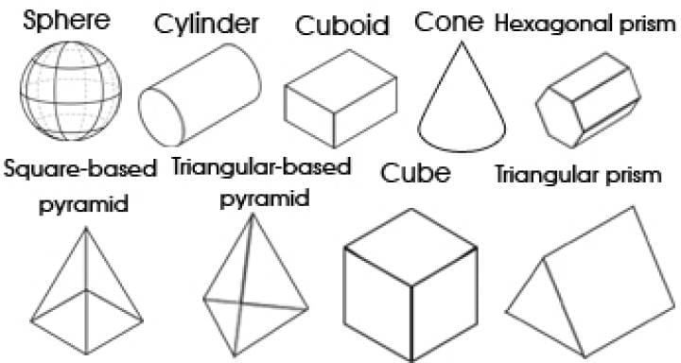
Three-Dimensional Geometric Transformation
2D is “flat” using the horizontal and vertical (X & Y) dimensions, the image has only two dimensions. 3D adds the depth (Z) dimension.
We can perform different transformation by specifying the three dimensional transformation vector, however the 3D transformation is more complex than 2D transformation.
An object that has height, width and depth, like any object in the real world is a 3 dimensional object.
Types of objects: Geometrical shapes, trees, terrains, clouds, rocks, glass, hair, furniture, human body, etc.

Slide 4
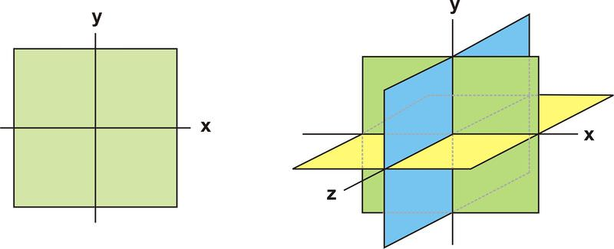
Three-Dimensional Coordinate

Slide 5
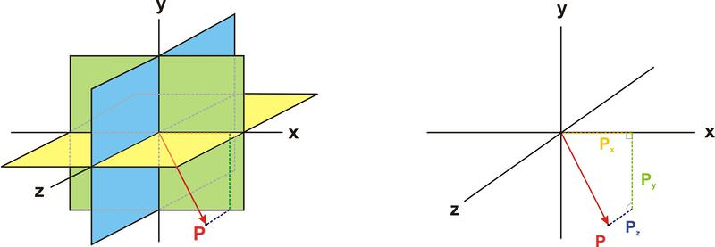
Three-Dimensional Coordinate

Slide 6
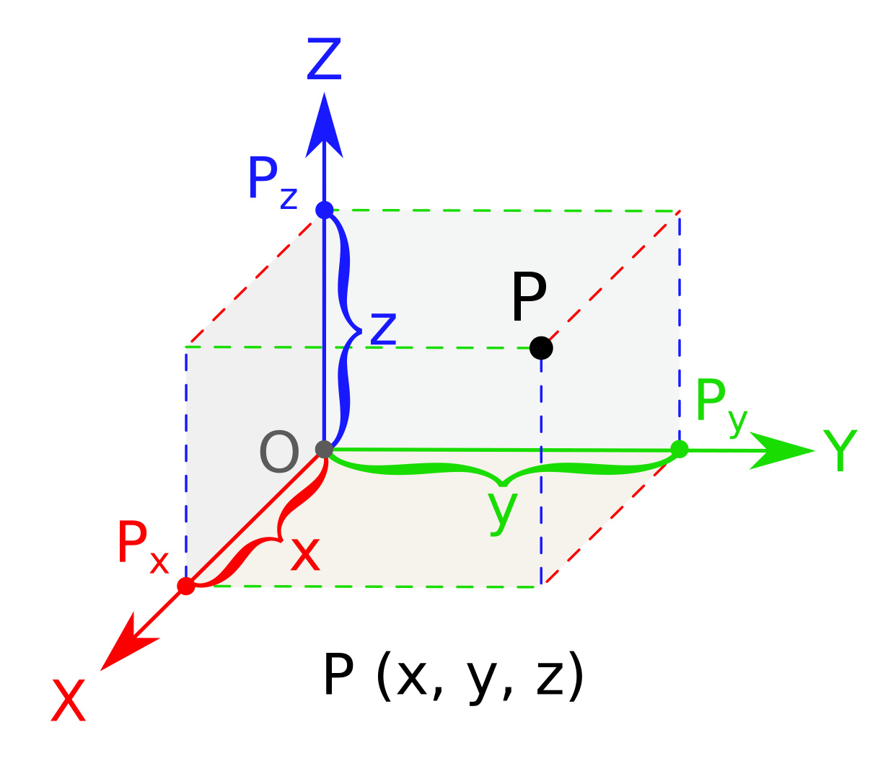
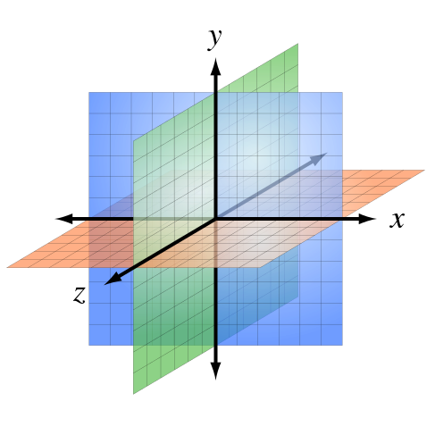
Three-Dimensional Coordinate

Slide 7
Three-Dimensional Geometric Transformation
Just as 2D-transfromtions can be represented by 3x3 matrices using homogeneous co-ordinate, 3D-transformations can be represented by 4x4 matrices. We use homogenous co-ordinate representation of points in 3D space as well.
Various types of three dimensional transformations are:
Translation
Rotation
Scaling
Reflection
Shear

Slide 8
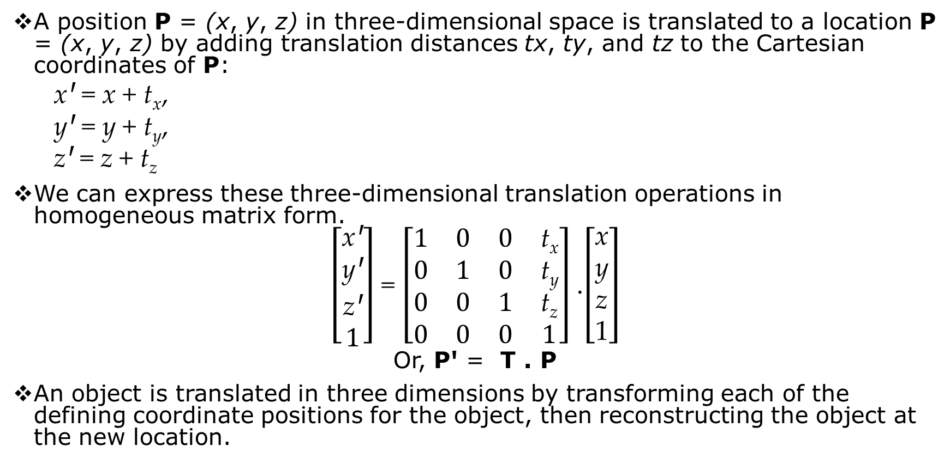
Three-Dimensional Translation
A position P = (x, y, z) in three-dimensional space is translated to a location P = (x, y, z) by adding translation distances tx, ty, and tz to the Cartesian coordinates of P:
xꞋ = x + t_{x},
yꞋ = y + t_{y},
zꞋ = z + t_{z}
We can express these three-dimensional translation operations in homogeneous matrix form.
$\left[\begin{matrix}\text{x}\text{Ꞌ} \\ \text{y}\text{Ꞌ} \\ \text{z}\text{Ꞌ} \\ 1\end{matrix}\right]$ = $\left[\begin{matrix}1 & 0 & 0 & \text{t}\text{x} \\ 0 & 1 & 0 & \text{t}\text{y} \\ 0 & 0 & 1 & \text{t}\text{z} \\ 0 & 0 & 0 & 1\end{matrix}\right]$ .$\left[\begin{matrix}\text{x} \\ \text{y} \\ \text{z} \\ \text{1}\end{matrix}\right]$
Or, PꞋ = T . P
An object is translated in three dimensions by transforming each of the defining coordinate positions for the object, then reconstructing the object at the new location.

Slide 9
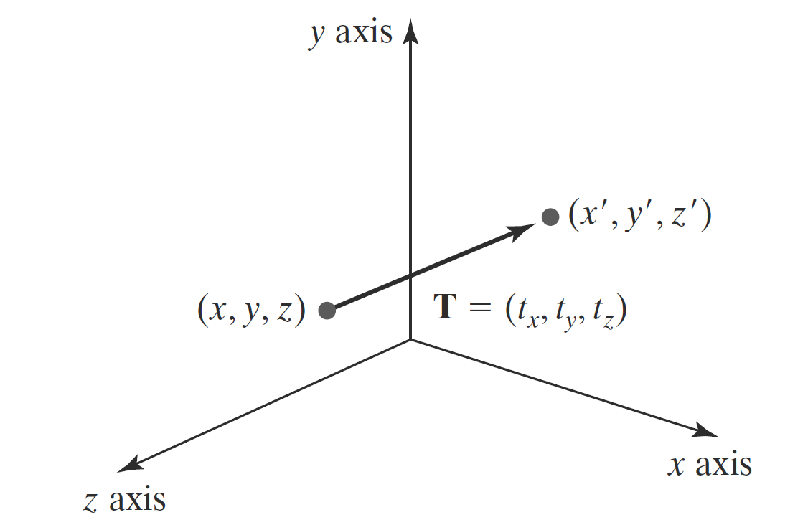
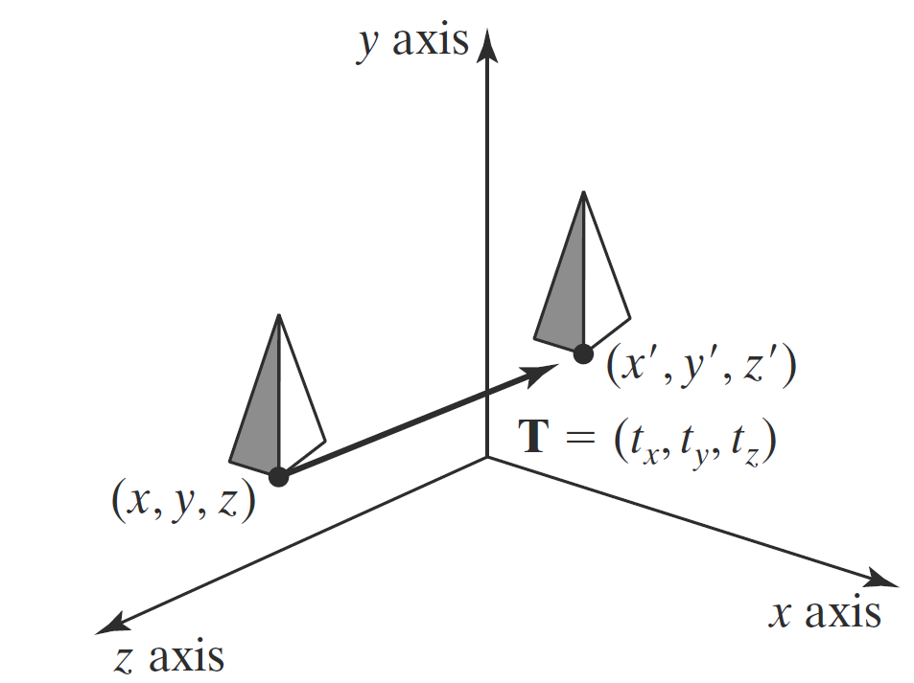
Three-Dimensional Translation
FIGURE: Moving a coordinate position with translation vector T = (t_{x} ,t_{y} ,t_{z}) .
FIGURE: Shifting the position of a three-dimensional object using translation vector T.

Slide 10
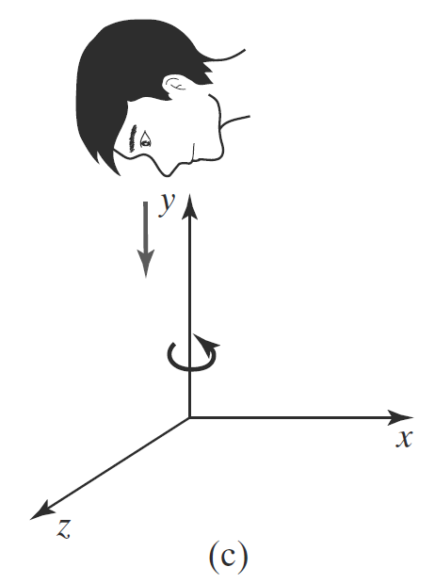
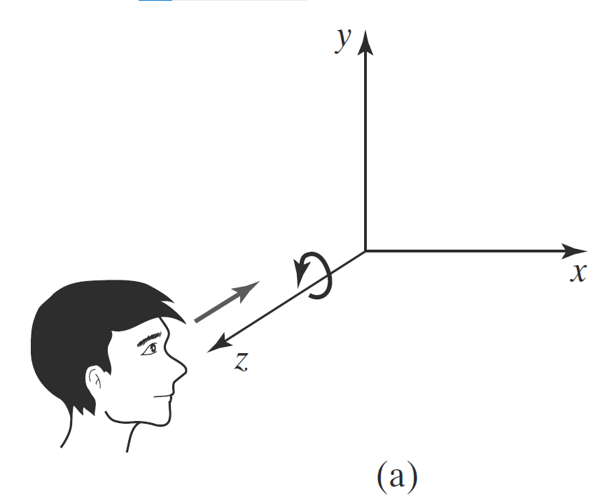
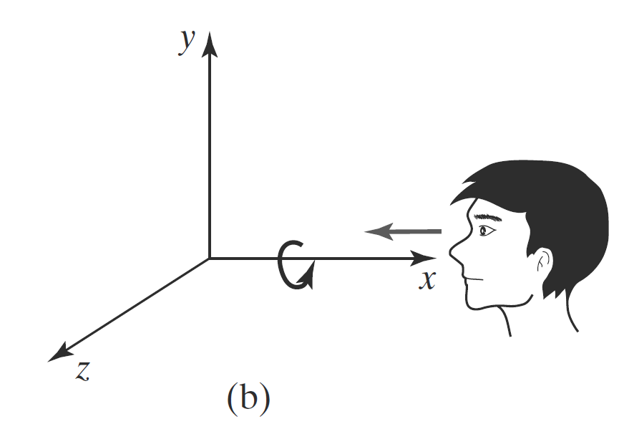
Three-Dimensional Rotation
We can rotate an object about any axis in space, but the easiest rotation axes to handle are those that are parallel to the Cartesian-coordinate axes.
By convention, positive rotation angles produce counterclockwise rotations about a coordinate axis, assuming that we are looking in the negative direction along that coordinate axis.

Slide 11
Three-Dimensional Coordinate-Axis Rotations
We can rotate an object about any axis in space, but the easiest rotation axes to handle are those that are parallel to the Cartesian-coordinate axes.
By convention, positive rotation angles produce counterclockwise rotations about a coordinate axis, assuming that we are looking in the negative direction along that coordinate axis.
Types of three dimensional rotations(Coordinate axes rotations):
Rotation about the z-axis(Roll)
Rotation about the x-axis(Pitch)
Rotation about the y-axis(Yaw)
An inverse three-dimensional rotation matrix is obtained in the same way as the inverse rotations in two dimensions. We just replace the angle θ with −θ.

Slide 12
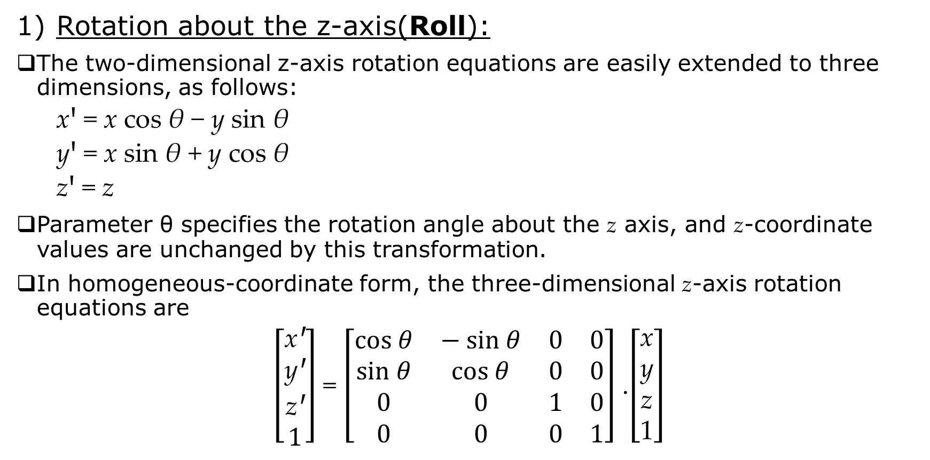
Three-Dimensional Coordinate-Axis Rotations
Rotation about the z-axis(Roll):
The two-dimensional z-axis rotation equations are easily extended to three dimensions, as follows:
xꞋ = x cos θ − y sin θ
yꞋ = x sin θ + y cos θ
zꞋ = z
Parameter θ specifies the rotation angle about the z axis, and z-coordinate values are unchanged by this transformation.
In homogeneous-coordinate form, the three-dimensional z-axis rotation equations are
$\left[\begin{matrix}\text{x}\text{Ꞌ} \\ \text{y}\text{Ꞌ} \\ \text{z}\text{Ꞌ} \\ 1\end{matrix}\right]$ = $\left[\begin{matrix}cos θ & − sin θ & 0 & \text{0} \\ sin θ & cos θ & 0 & \text{0} \\ 0 & 0 & 1 & \text{0} \\ 0 & 0 & 0 & 1\end{matrix}\right]$ .$\left[\begin{matrix}\text{x} \\ \text{y} \\ \text{z} \\ \text{1}\end{matrix}\right]$

Slide 13
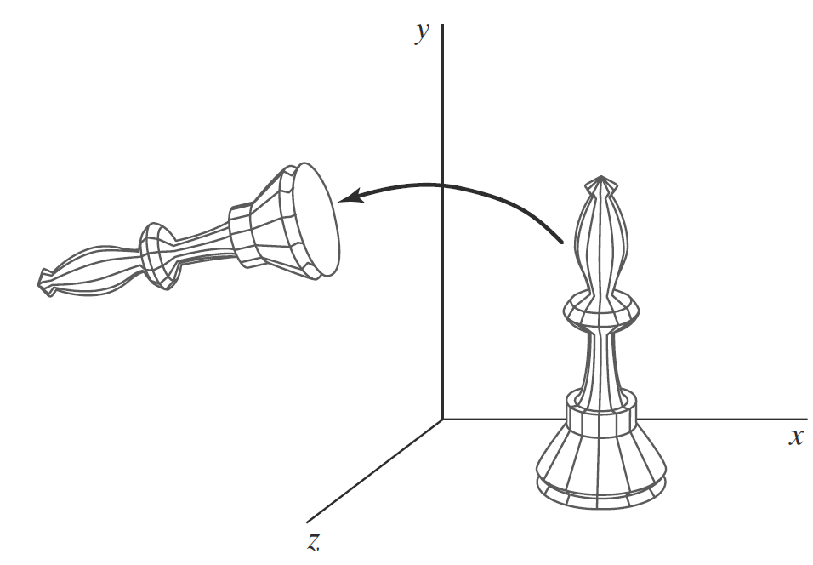
Three-Dimensional Coordinate-Axis Rotations
Rotation about the z-axis(Roll):
which we can write more compactly as
PꞋ = R_{z}(θ) · P
Transformation equations for rotations about the other two coordinate axes can be obtained with a cyclic permutation of the coordinate parameters x, y, and z in z axis rotation Equations :
x → y→ z→ x
Thus, to obtain the x-axis and y-axis rotation transformations, we cyclically replace x with y, y with z, and z with x.
FIGURE: Rotation of an object about the z axis.

Slide 14
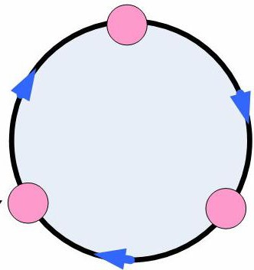
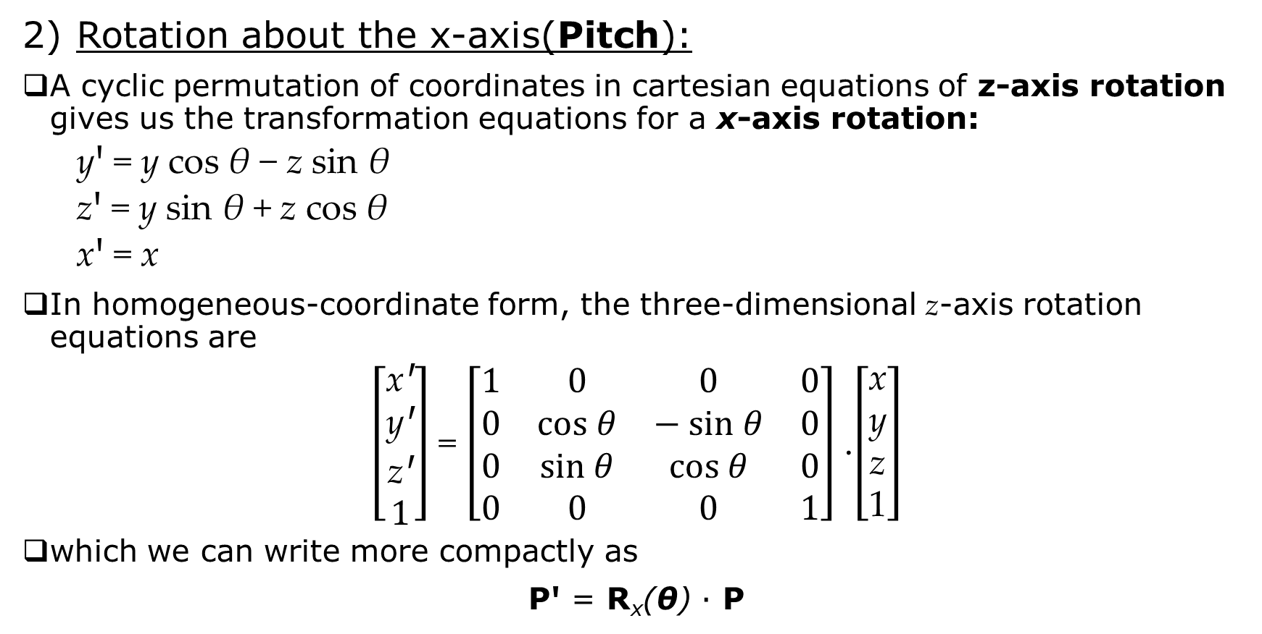
Three-Dimensional Coordinate-Axis Rotations
Rotation about the x-axis(Pitch):
A cyclic permutation of coordinates in cartesian equations of z-axis rotation gives us the transformation equations for a x-axis rotation:
yꞋ = y cos θ − z sin θ
zꞋ = y sin θ + z cos θ
xꞋ = x
In homogeneous-coordinate form, the three-dimensional z-axis rotation equations are
$\left[\begin{matrix}\text{x}\text{Ꞌ} \\ \text{y}\text{Ꞌ} \\ \text{z}\text{Ꞌ} \\ 1\end{matrix}\right]$ = $\left[\begin{matrix}1 & 0 & 0 & \text{0} \\ 0 & cos θ & − sin θ & \text{0} \\ 0 & sin θ & cos θ & \text{0} \\ 0 & 0 & 0 & 1\end{matrix}\right]$ .$\left[\begin{matrix}\text{x} \\ \text{y} \\ \text{z} \\ \text{1}\end{matrix}\right]$
which we can write more compactly as
PꞋ = R_{x}(θ) · P
X
Z
Y

Slide 15
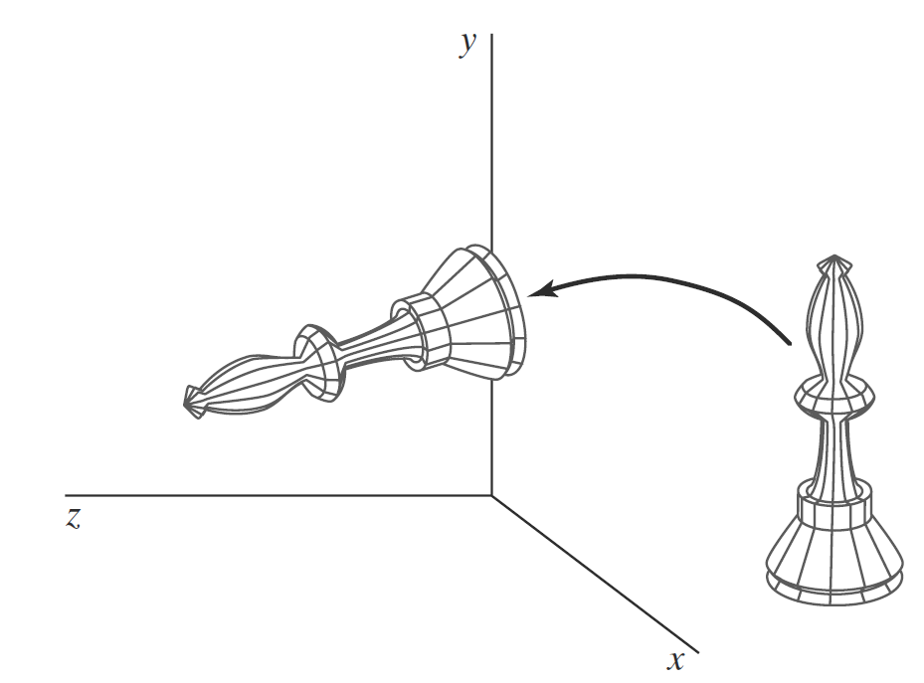
Three-Dimensional Coordinate-Axis Rotations
Rotation about the x-axis(Pitch):
FIGURE: Rotation of an object about the x axis.

Slide 16
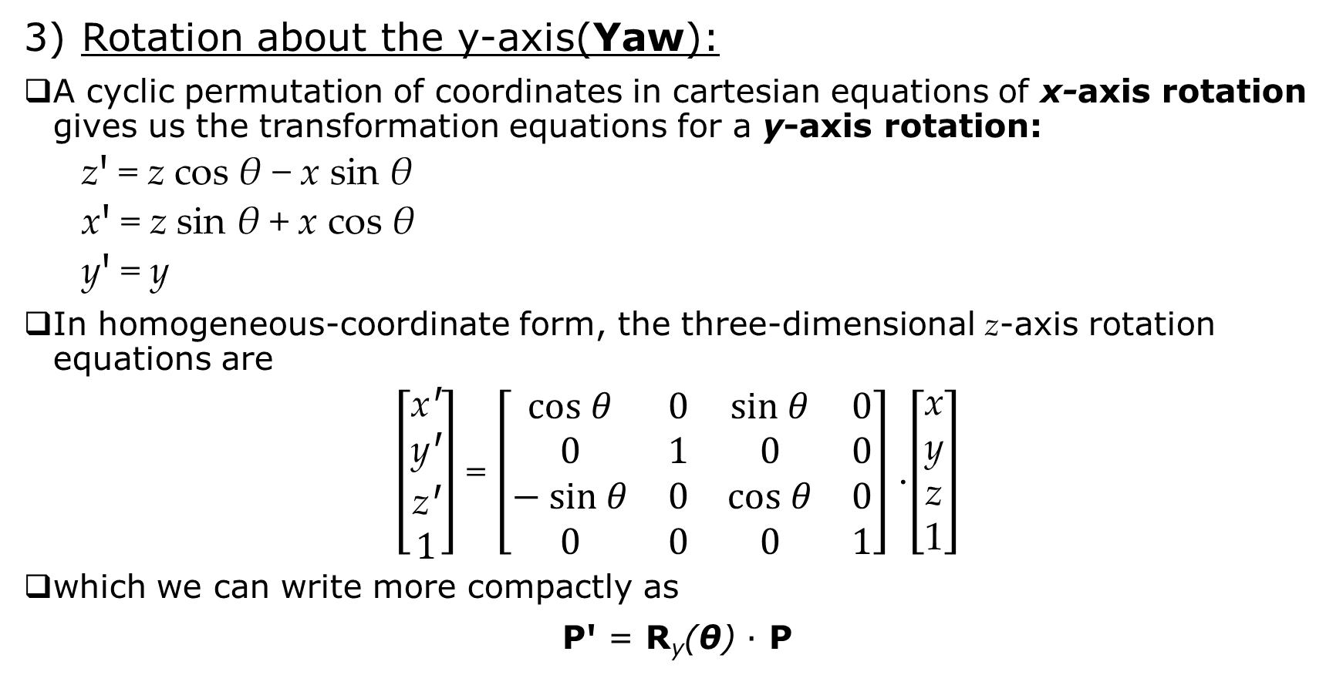
Three-Dimensional Coordinate-Axis Rotations
Rotation about the y-axis(Yaw):
A cyclic permutation of coordinates in cartesian equations of x-axis rotation gives us the transformation equations for a y-axis rotation:
zꞋ = z cos θ − x sin θ
xꞋ = z sin θ + x cos θ
yꞋ = y
In homogeneous-coordinate form, the three-dimensional z-axis rotation equations are
$\left[\begin{matrix}\text{x}\text{Ꞌ} \\ \text{y}\text{Ꞌ} \\ \text{z}\text{Ꞌ} \\ 1\end{matrix}\right]$ = $\left[\begin{matrix}cos θ & 0 & sin θ & \text{0} \\ 0 & 1 & 0 & \text{0} \\ − sin θ & 0 & cos θ & \text{0} \\ 0 & 0 & 0 & 1\end{matrix}\right]$ .$\left[\begin{matrix}\text{x} \\ \text{y} \\ \text{z} \\ \text{1}\end{matrix}\right]$
which we can write more compactly as
PꞋ = R_{y}(θ) · P

Slide 17
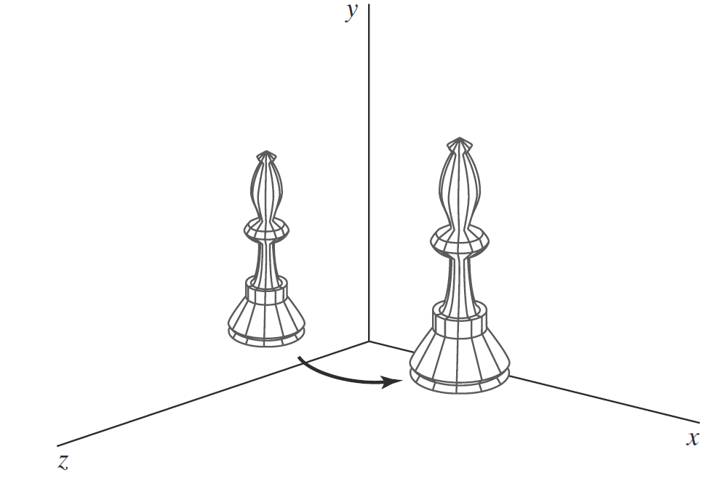
Three-Dimensional Coordinate-Axis Rotations
Rotation about the y-axis(Yaw):
FIGURE: Rotation of an object about the y axis.

Slide 18
General Three-Dimensional Rotations
A rotation matrix for any axis that does not coincide with a coordinate axis can be set up as a composite transformation involving combinations of translations and the coordinate-axis rotations.
Parallel to any of the co-axis
Not parallel to any of the co-axis

Slide 19
General Three-Dimensional Rotations
Parallel to any of the co-axis:
In the special case where an object is to be rotated about an axis that is parallel to one of the coordinate axes, we attain the desired rotation with the following transformation sequence:
Translate the object so that the rotation axis coincides with the parallel coordinate axis.
Perform the specified rotation about that axis.
Translate the object so that the rotation axis is moved back to its original position.

Slide 20
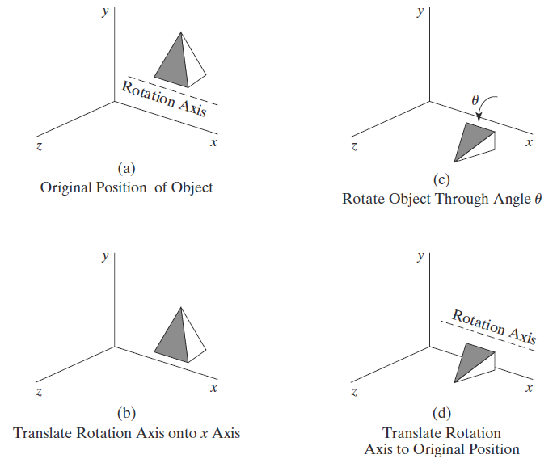
General Three-Dimensional Rotations
FIGURE: Sequence of transformations for rotating an object about an axis that is parallel to the x axis.

Slide 21
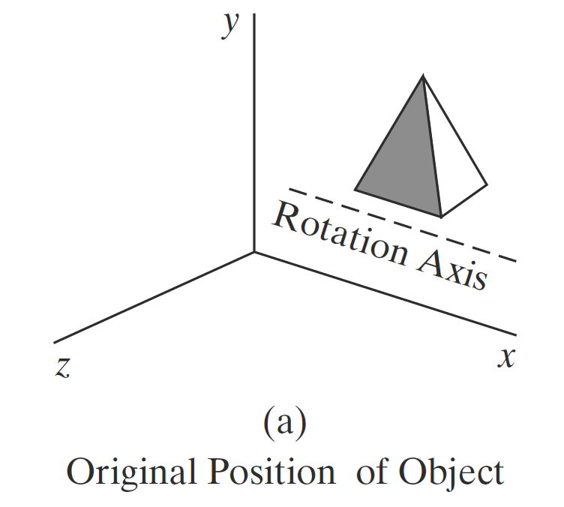
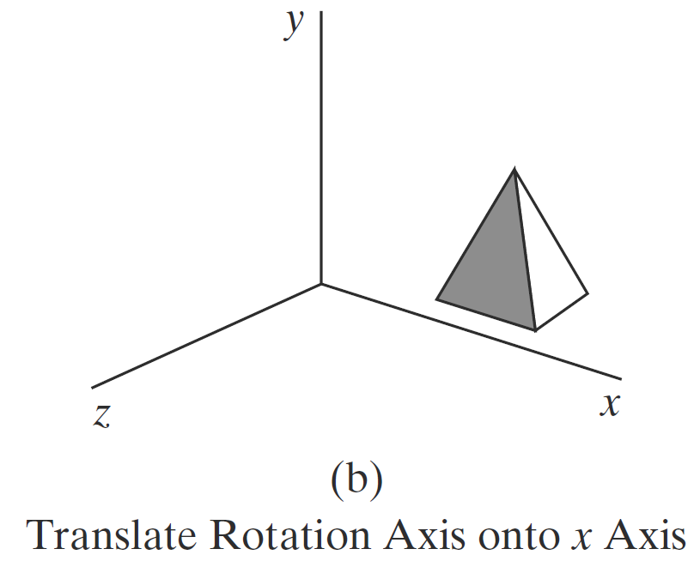
General Three-Dimensional Rotations

Slide 22
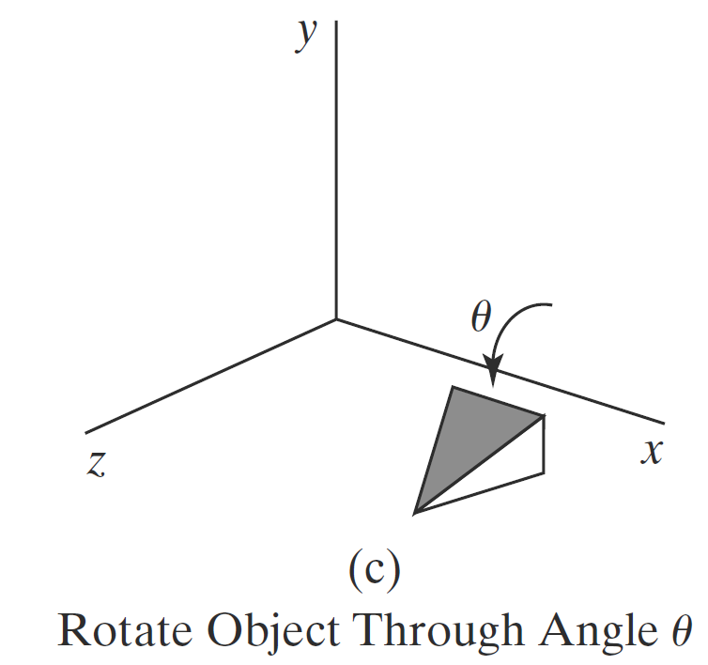
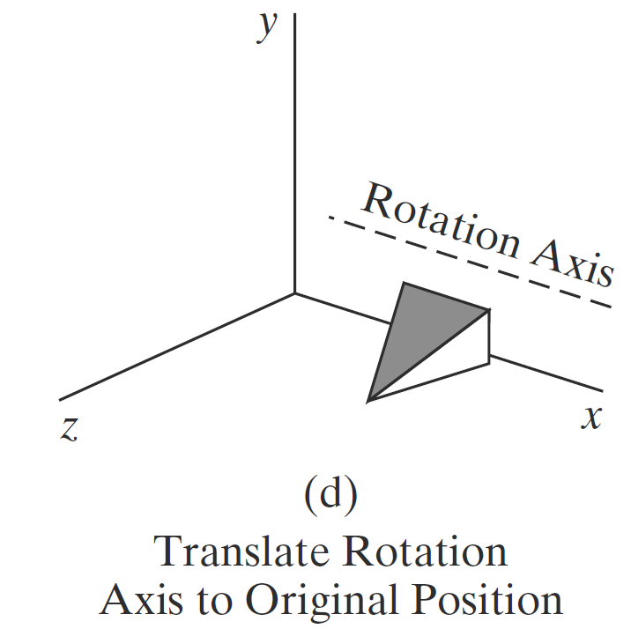
General Three-Dimensional Rotations

Slide 23
General Three-Dimensional Rotations
A coordinate position P is transformed with the sequence shown in this figure as
PꞋ = T⁻¹ · R_{x}(θ) · T · P
where the composite rotation matrix for the transformation is
C.M. = T⁻¹ · R_{x}(θ) · T
This composite matrix is of the same form as the two-dimensional transformation sequence for rotation about an axis that is parallel to the z axis (a pivot point that is not at the coordinate origin).

Slide 24
General Three-Dimensional Rotations
Not parallel to any of the co-axis:
When an object is to be rotated about an axis that is not parallel to one of the coordinate axes, we must perform some additional transformations.
In this case, we also need rotations to align the rotation axis with a selected coordinate axis and then to bring the rotation axis back to its original orientation.
Given the specifications for the rotation axis and the rotation angle, we can accomplish the required rotation in five steps:
Translate the object so that the rotation axis passes through the coordinate origin.
Rotate the object so that the axis of rotation coincides with one of the coordinate axes.
Perform the specified rotation about the selected coordinate axis.
Apply inverse rotations to bring the rotation axis back to its original orientation.
Apply the inverse translation to bring the rotation axis back to its original spatial position.

Slide 25
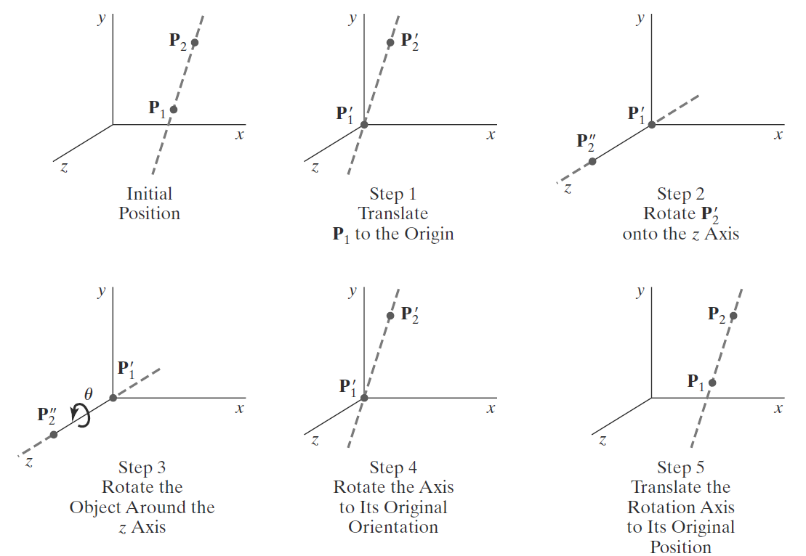
General Three-Dimensional Rotations
FIGURE: Five transformation steps for obtaining a composite matrix for rotation about an arbitrary axis, with the rotation axis projected onto the z axis.

Slide 26
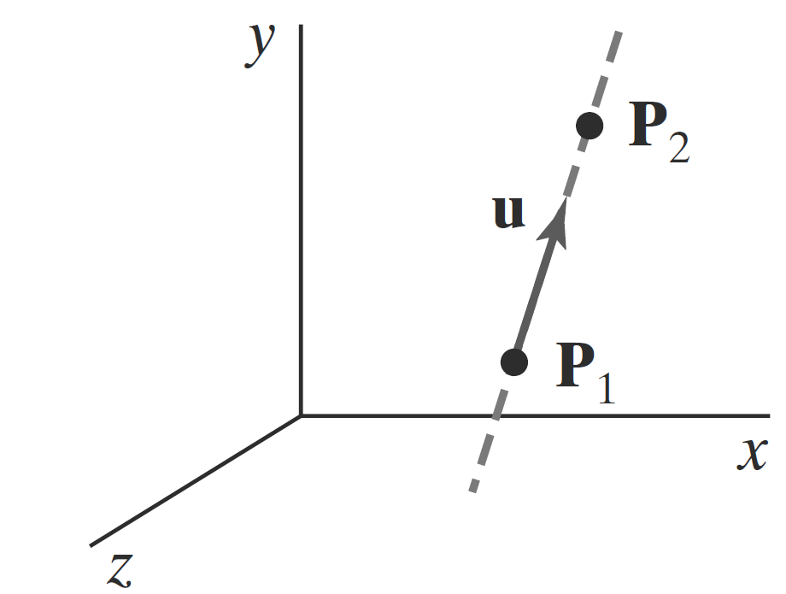
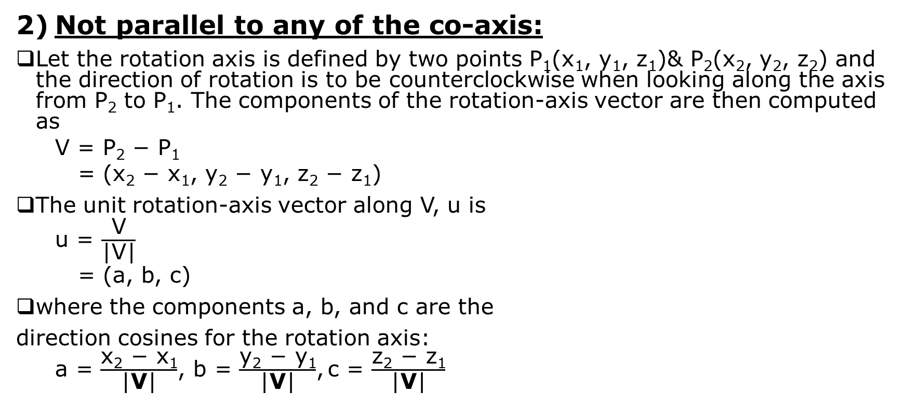
General Three-Dimensional Rotations
Not parallel to any of the co-axis:
Let the rotation axis is defined by two points P₁(x₁, y₁, z₁)& P₂(x₂, y₂, z₂) and the direction of rotation is to be counterclockwise when looking along the axis from P₂ to P₁. The components of the rotation-axis vector are then computed as
V = P₂ − P₁
= (x₂ − x₁, y₂ − y₁, z₂ − z₁)
The unit rotation-axis vector along V, u is
u = $\frac{\text{V}}{\text{|}\text{V}\text{|}}$
= (a, b, c)
where the components a, b, and c are the
direction cosines for the rotation axis:
a = $\frac{\text{x}\text{2}\text{ − }\text{x}\text{1}}{\text{|}\text{V}\text{|}}$, b = $\frac{\text{y}\text{2}\text{ − }\text{y}\text{1}}{\text{|}\text{V}\text{|}}$, c = $\frac{\text{z}\text{2}\text{ − }\text{z}\text{1}}{\text{|}\text{V}\text{|}}$
FIGURE: An axis of rotation (dashed line) defined with points P₁ and P₂. The direction for the unit axis vector u is determined by the specified rotation direction.
Notes:
If the rotation is to be in the opposite direction (clockwise when viewing from P₂ to P₁), then we would reverse axis vector V and unit vector u so that they point in the direction from P₂ to P₁.

Slide 27
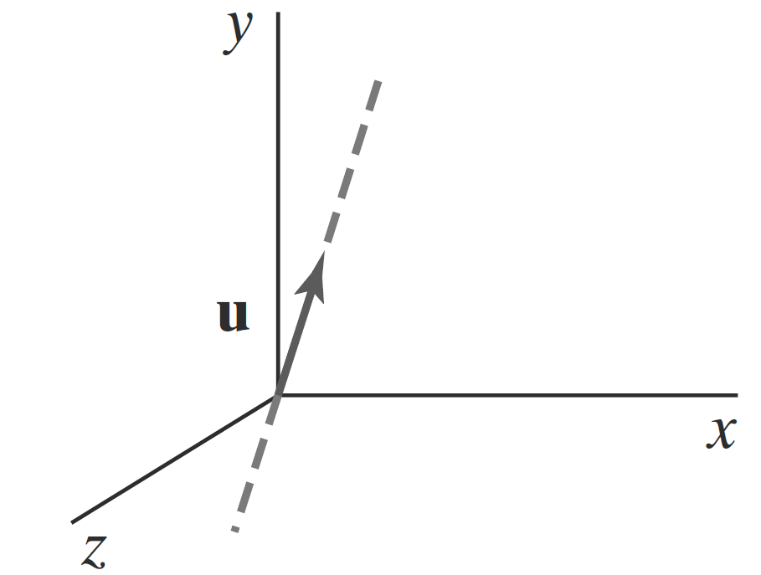
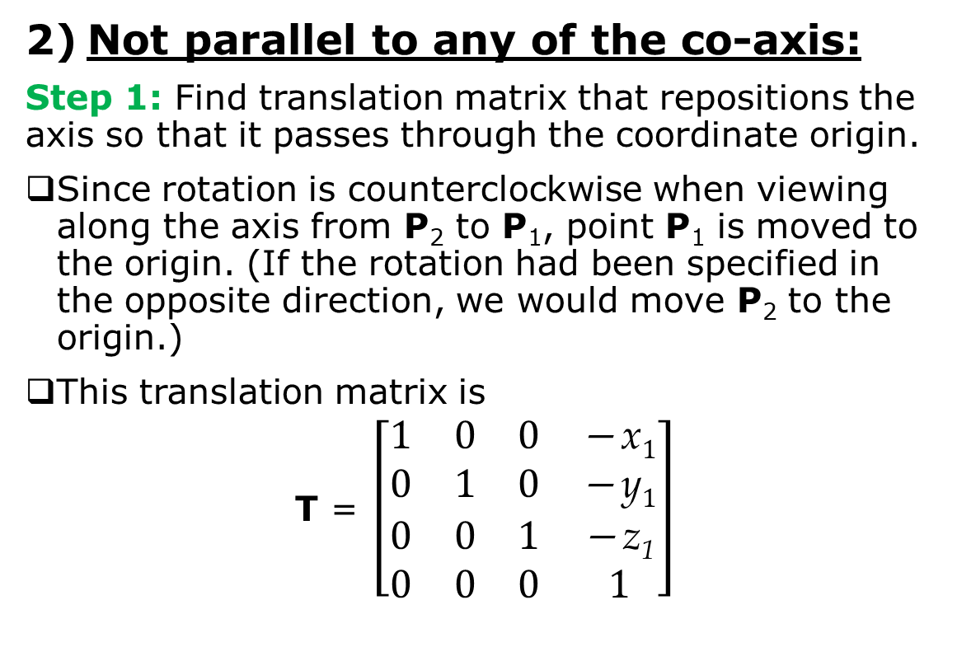
General Three-Dimensional Rotations
Not parallel to any of the co-axis:
Step 1: Find translation matrix that repositions the axis so that it passes through the coordinate origin.
Since rotation is counterclockwise when viewing along the axis from P₂ to P₁, point P₁ is moved to the origin. (If the rotation had been specified in the opposite direction, we would move P₂ to the origin.)
This translation matrix is
T = $\left[\begin{matrix}1 & 0 & 0 & \text{− }\text{x}1 \\ 0 & 1 & 0 & \text{− }\text{y}1 \\ 0 & 0 & 1 & \text{− }\text{z}\text{1} \\ 0 & 0 & 0 & 1\end{matrix}\right]$
FIGURE: Translation of the rotation axis to the coordinate origin.

Slide 28
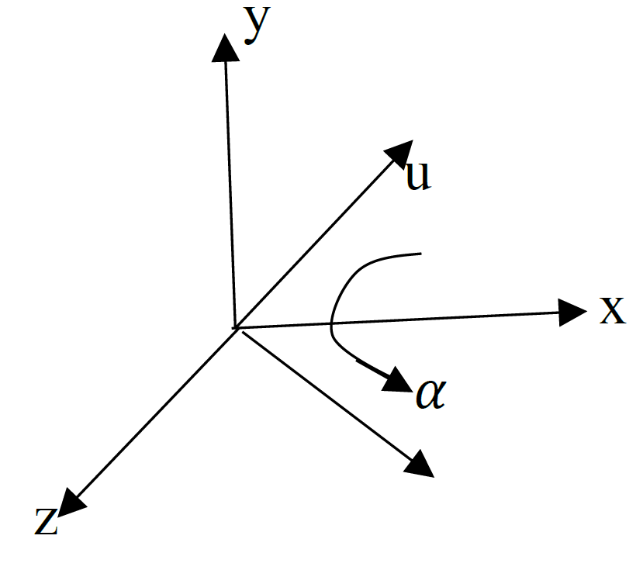
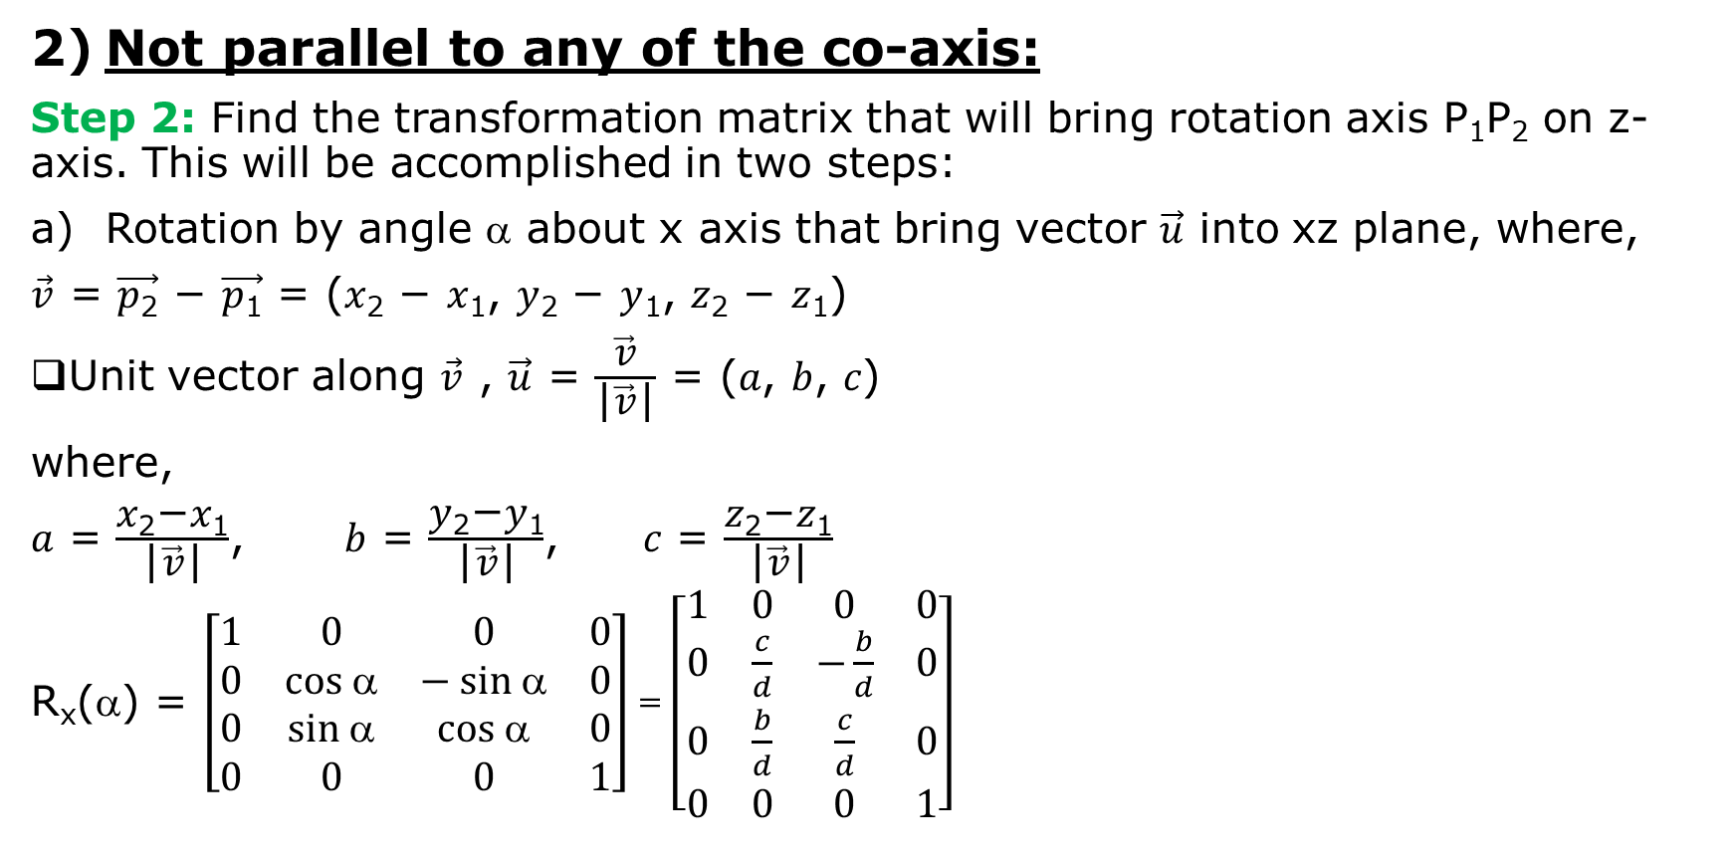

General Three-Dimensional Rotations
Not parallel to any of the co-axis:
Step 2: Find the transformation matrix that will bring rotation axis P₁P₂ on z-axis. This will be accomplished in two steps:
Rotation by angle α about x axis that bring vector $\vec{\text{u}}$ into xz plane, where,
$\vec{\text{v}}$ = $\vec{\text{p}\text{2}}$ − $\vec{\text{p}\text{1}}$ = (𝑥₂ − 𝑥₁, 𝑦₂ − 𝑦₁, 𝑧₂ − 𝑧₁)
Unit vector along $\vec{\text{v}}$ , $\vec{\text{u}}$ = $\frac{\vec{\text{v}}}{\text{|}\vec{\text{v}}\text{|}}$ = (𝑎, 𝑏, 𝑐)
where,
𝑎 = $\frac{\text{x}\text{2}\text{−}\text{x}\text{1}}{\text{|}\vec{\text{v}}\text{|}}$, 𝑏 = $\frac{\text{y}\text{2}\text{−}\text{y}\text{1}}{\text{|}\vec{\text{v}}\text{|}}$, 𝑐 = $\frac{\text{z}\text{2}\text{−}\text{z}\text{1}}{\text{|}\vec{\text{v}}\text{|}}$
R_{x}(α) = $\left[\begin{matrix}1 & 0 & 0 & \text{0} \\ 0 & cos α & − sin α & \text{0} \\ 0 & sin α & cos α & \text{0} \\ 0 & 0 & 0 & 1\end{matrix}\right]$ = $\left[\begin{matrix}1 & 0 & 0 & \text{0} \\ 0 & \frac{c}{d} & −\frac{b}{d} & \text{0} \\ 0 & \frac{b}{d} & \frac{c}{d} & \text{0} \\ 0 & 0 & 0 & 1\end{matrix}\right]$
Where, 𝑑 = $\sqrt{\text{b}\text{2}\text{ + }\text{c}\text{2}}$

Slide 29
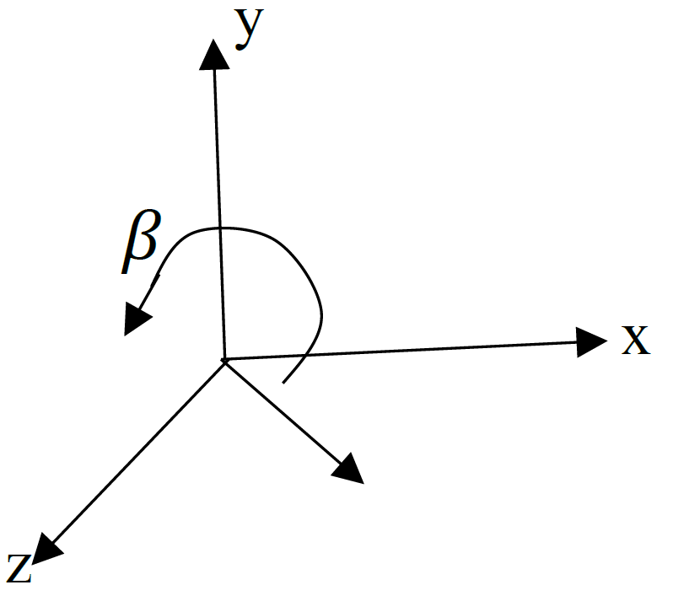

General Three-Dimensional Rotations
Not parallel to any of the co-axis:
Step 2: Find transformation that will bring rotation axis P1P2 on z-axis. This will be accomplished in two steps:
Rotate by angle β about y axis that brings $\vec{\text{u}}$ on z-axis.
R_{y}(β) = $\left[\begin{matrix}cos β & 0 & sin β & \text{0} \\ 0 & 1 & 0 & \text{0} \\ − sin β & 0 & cos β & \text{0} \\ 0 & 0 & 0 & 1\end{matrix}\right]$ = $\left[\begin{matrix}d & 0 & − a & \text{0} \\ 0 & 1 & 0 & \text{0} \\ a & 0 & d & \text{0} \\ 0 & 0 & 0 & 1\end{matrix}\right]$

Slide 30
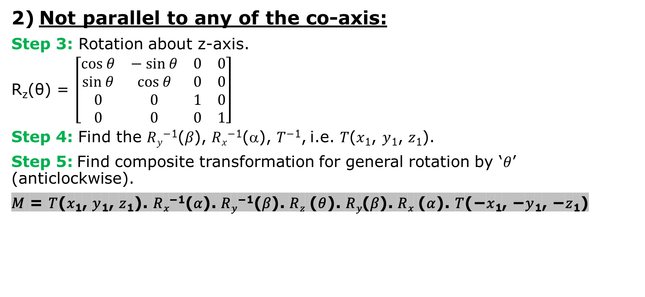
General Three-Dimensional Rotations
Not parallel to any of the co-axis:
Step 3: Rotation about z-axis.
R_{z}(θ) = $\left[\begin{matrix}cos θ & − sin θ & 0 & \text{0} \\ sin θ & cos θ & 0 & \text{0} \\ 0 & 0 & 1 & \text{0} \\ 0 & 0 & 0 & 1\end{matrix}\right]$
Step 4: Find the 𝑅_{𝑦}⁻¹(𝛽), 𝑅_{𝑥}⁻¹(α), 𝑇⁻¹, i.e. 𝑇(𝑥₁, 𝑦₁, 𝑧₁).
Step 5: Find composite transformation for general rotation by ‘𝜃’ (anticlockwise).
𝑀 = 𝑇(𝑥₁, 𝑦₁, 𝑧₁). 𝑅_{𝑥}⁻¹(𝛼). 𝑅_{𝑦}⁻¹(𝛽). 𝑅_{𝑧} (𝜃). 𝑅_{𝑦}(𝛽). 𝑅_{𝑥} (𝛼). 𝑇(−𝑥₁, −𝑦₁, −𝑧₁)

Slide 31
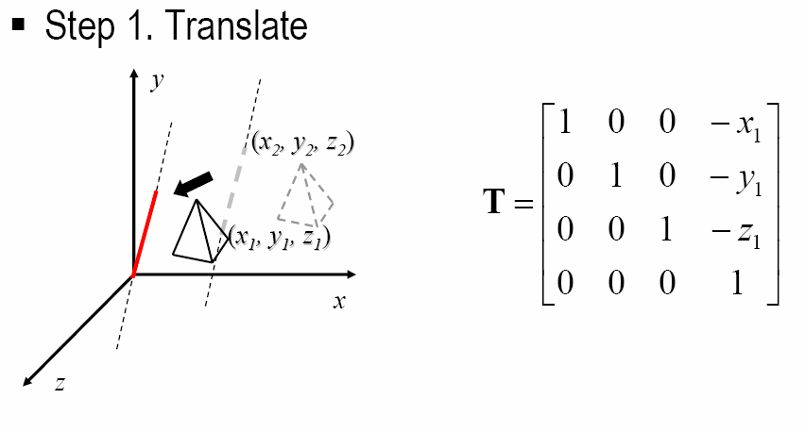
General Three-Dimensional Rotations
Not parallel to any of the co-axis:

Slide 32
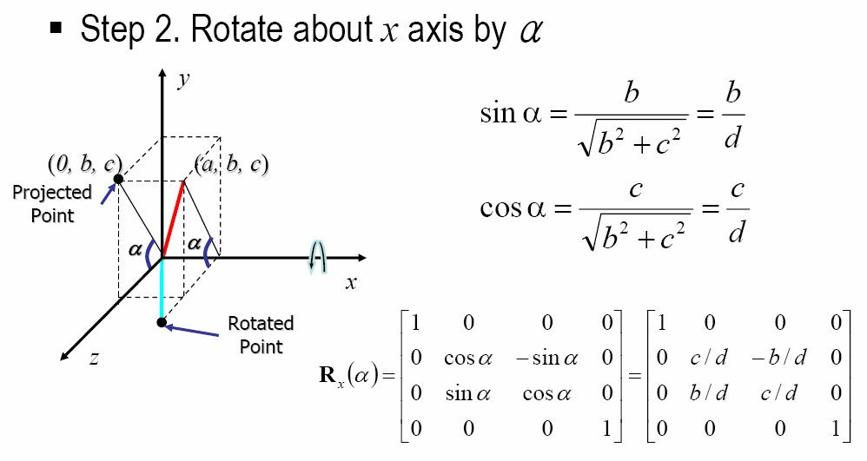
General Three-Dimensional Rotations
Not parallel to any of the co-axis:

Slide 33
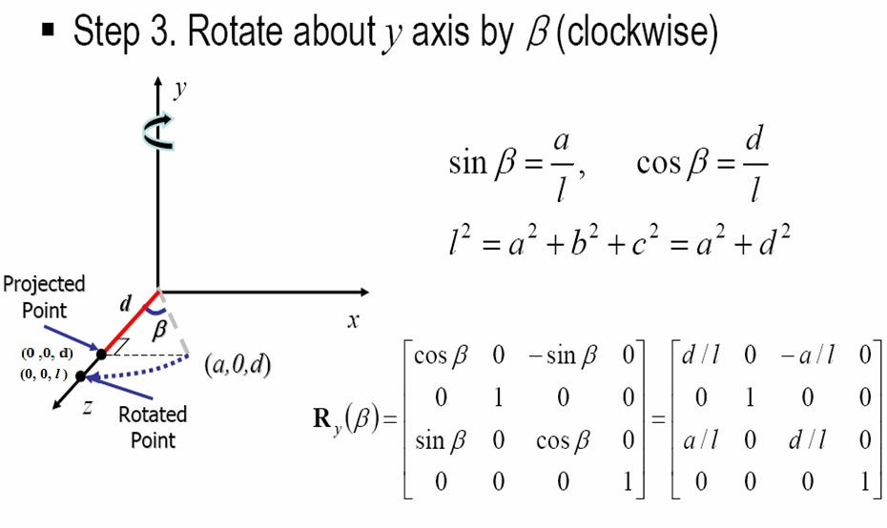
General Three-Dimensional Rotations
Not parallel to any of the co-axis:

Slide 34
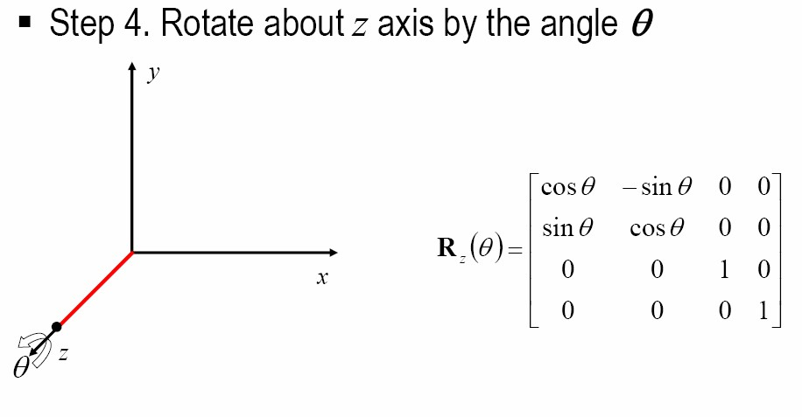
General Three-Dimensional Rotations
Not parallel to any of the co-axis:

Slide 35
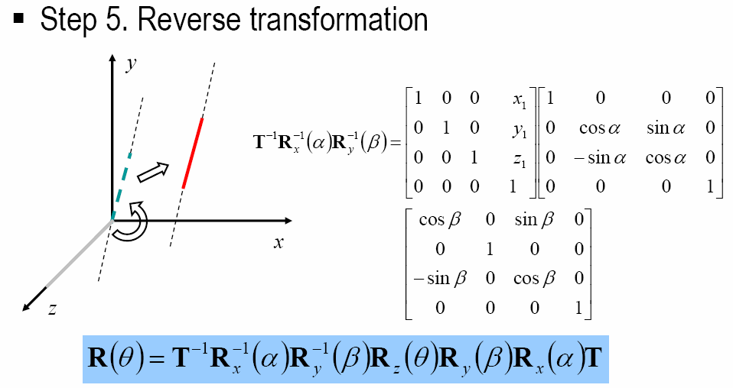
General Three-Dimensional Rotations
Not parallel to any of the co-axis:

Slide 36
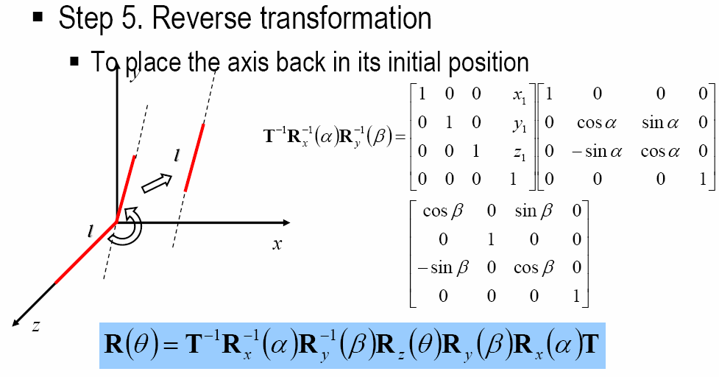
General Three-Dimensional Rotations
Not parallel to any of the co-axis:

Slide 37
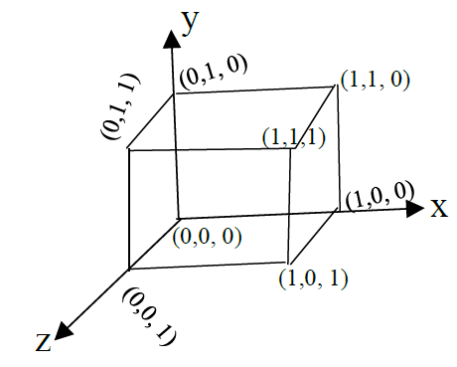
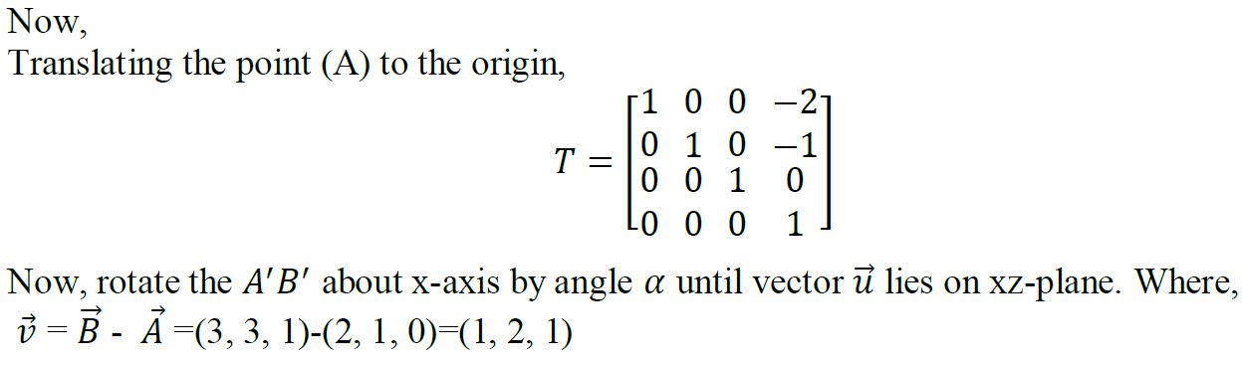
Numerical Problem
Q. Find the new co-ordinates of a unit cube 90 degree rotated about an axis defined by its end points A(2, 1, 0) and B(3, 3, 1).
Solution:
Fig: unit cube

Slide 38
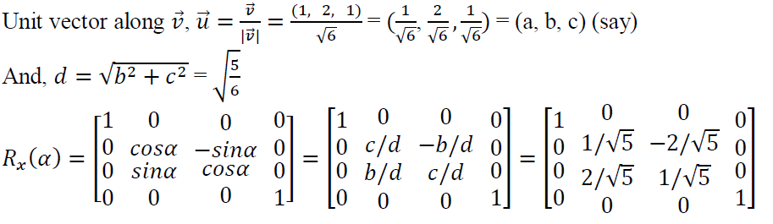
Numerical Problem
Q. Find the new co-ordinates of a unit cube 90 degree rotated about an axis defined by its end points A(2, 1, 0) and B(3, 3, 1).
Solution:

Slide 39
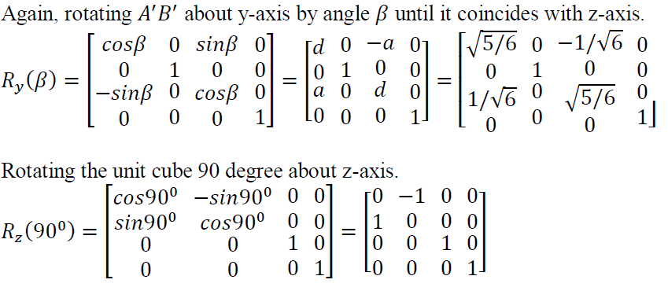
Numerical Problem
Q. Find the new co-ordinates of a unit cube 90 degree rotated about an axis defined by its end points A(2, 1, 0) and B(3, 3, 1).
Solution:

Slide 40
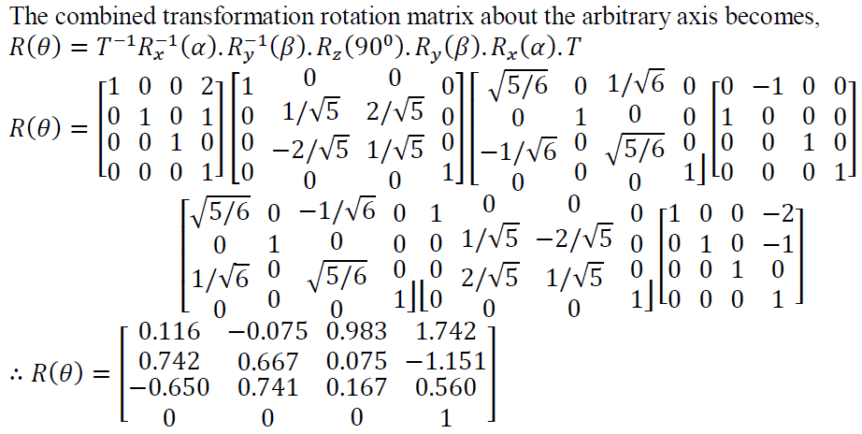
Numerical Problem
Q. Find the new co-ordinates of a unit cube 90 degree rotated about an axis defined by its end points A(2, 1, 0) and B(3, 3, 1).
Solution:

Slide 41
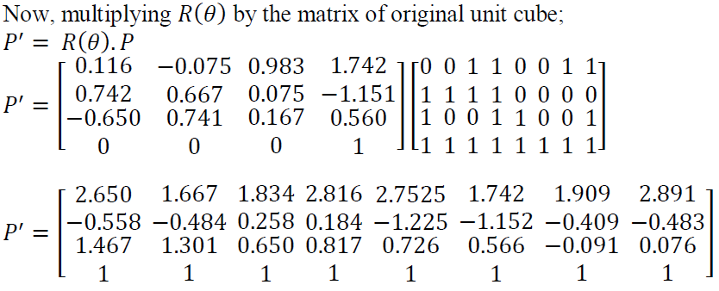
Numerical Problem
Q. Find the new co-ordinates of a unit cube 90 degree rotated about an axis defined by its end points A(2, 1, 0) and B(3, 3, 1).
Solution:

Slide 42
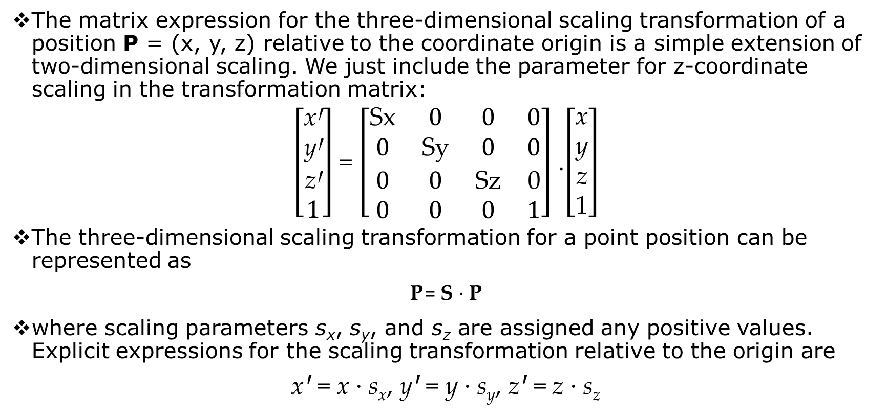
Three-Dimensional Scaling
The matrix expression for the three-dimensional scaling transformation of a position P = (x, y, z) relative to the coordinate origin is a simple extension of two-dimensional scaling. We just include the parameter for z-coordinate scaling in the transformation matrix:
$\left[\begin{matrix}\text{x}\text{Ꞌ} \\ \text{y}\text{Ꞌ} \\ \text{z}\text{Ꞌ} \\ 1\end{matrix}\right]$ = $\left[\begin{matrix}\text{Sx} & 0 & 0 & 0 \\ 0 & \text{Sy} & 0 & 0 \\ 0 & 0 & \text{Sz} & \text{0} \\ 0 & 0 & 0 & 1\end{matrix}\right]$ .$\left[\begin{matrix}\text{x} \\ \text{y} \\ \text{z} \\ \text{1}\end{matrix}\right]$
The three-dimensional scaling transformation for a point position can be represented as
P = S · P
where scaling parameters s_{x}, s_{y}, and s_{z} are assigned any positive values. Explicit expressions for the scaling transformation relative to the origin are
xꞋ = x · s_{x}, yꞋ = y · s_{y}, zꞋ = z · s_{z}

Slide 43
Three-Dimensional Scaling
Scaling an object changes the position of the object relative to the coordinate origin.
A parameter value greater than 1 moves a point farther from the origin in the corresponding coordinate direction.
Similarly, a parameter value less than 1 moves a point closer to the origin in that coordinate direction.
Also, if the scaling parameters are not all equal, relative dimensions of a transformed object are changed.
We preserve the original shape of an object with a uniform scaling: s_{x} = s_{y} = s_{z}. The result of scaling an object uniformly, with each scaling parameter set to 2, is illustrated in Figure below.

Slide 44
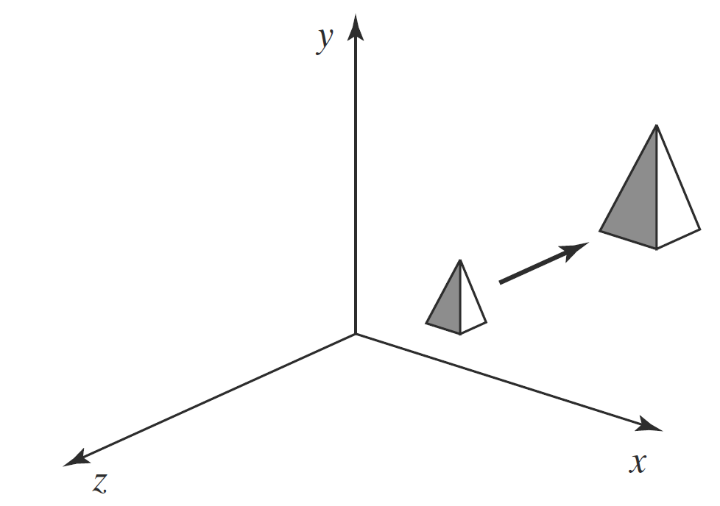
Three-Dimensional Scaling
FIGURE: Doubling the size of an object with scaling transformation also moves the object farther from the origin.

Slide 45
Three-Dimensional Fixed-Point Scaling
We can construct a scaling transformation with respect to any selected fixed position (x_{f}, y_{f}, z_{f}) using the following transformation sequence:
Translate the fixed point to the origin.
Apply the scaling transformation relative to the coordinate origin
Translate the fixed point back to its original position.
This sequence of transformations is demonstrated in Figure.

Slide 46
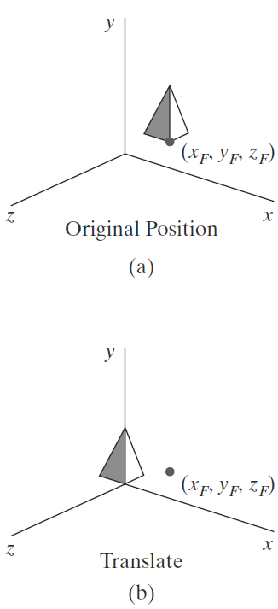
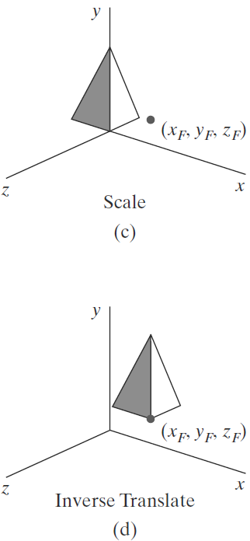
Three-Dimensional Fixed-Point Scaling
FIGURE: A sequence of transformations for scaling an object relative to a selected fixed point

Slide 47
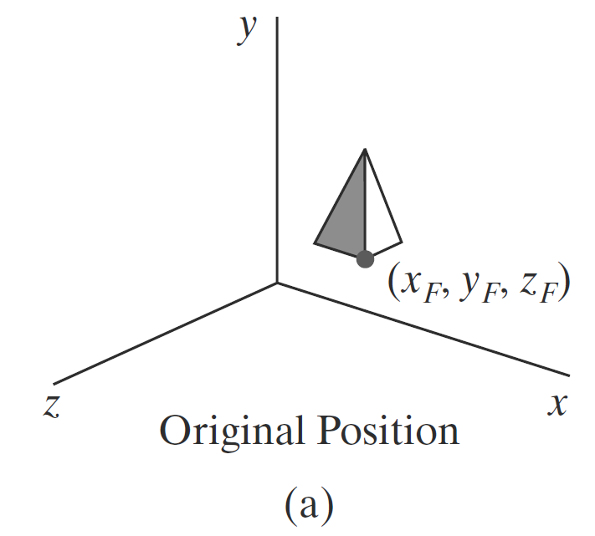
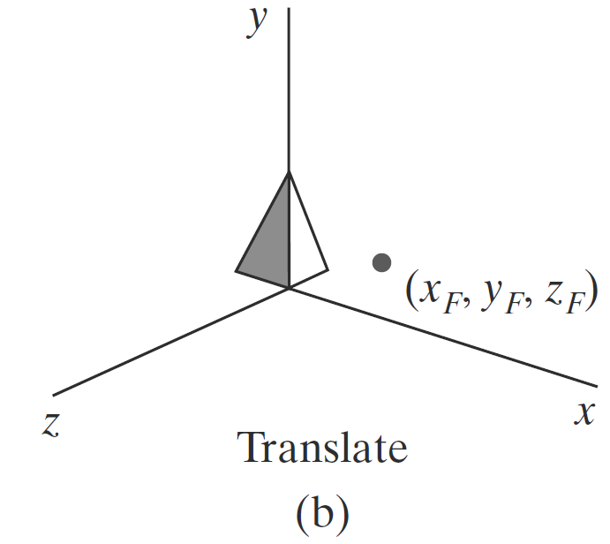
Three-Dimensional Fixed-Point Scaling

Slide 48


Three-Dimensional Fixed-Point Scaling

Slide 49

Three-Dimensional Fixed-Point Scaling
The matrix representation for an arbitrary fixed-point scaling can then be expressed as the concatenation of these translate-scale-translate transformations:
C.M./T.M. = T(x_{f}, y_{f}, z_{f}) · S(s_{x}, s_{y}, s_{z}) · T(−x_{f}, −y_{f}, −z_{f}) = $\left[\begin{matrix}\text{s}\text{x} & 0 & 0 & (1 −\text{s}\text{x})\text{x}\text{f} \\ 0 & \text{s}\text{y} & 0 & (1 −\text{s}\text{y})\text{y}\text{f} \\ 0 & 0 & \text{s}z & (1 −\text{s}\text{z})\text{z}\text{f} \\ 0 & 0 & 0 & 1\end{matrix}\right]$

Slide 50
Three-Dimensional Reflections
A reflection in a three-dimensional space can be performed relative to a selected reflection axis or with respect to a reflection plane.
In general, three-dimensional reflection matrices are set up similarly to those for two dimensions.
Reflections relative to a given axis are equivalent to 180◦ rotations about that axis.
Reflections with respect to a plane are similar; when the reflection plane is a coordinate plane (xy, xz, or yz), we can think of the transformation as a 180◦ rotation in four-dimensional space with a conversion between a left-handed frame and a right-handed frame.

Slide 51

Three-Dimensional Reflections
An example of a reflection that converts coordinate specifications from a right handed system to a left-handed system(or vice versa) is shown in Figure below. This transformation changes the sign of z coordinates, leaving the values for the x and y coordinates unchanged.

Slide 52

Three-Dimensional Reflections
The matrix representation for this reflection relative to the xy plane is
M_{zreflect} = $\left[\begin{matrix}\text{1} & 0 & 0 & 0 \\ 0 & \text{1} & 0 & 0 \\ 0 & 0 & \text{−1} & \text{0} \\ 0 & 0 & 0 & 1\end{matrix}\right]$
Transformation matrices for inverting x coordinates or y coordinates are defined similarly, as reflections relative to the yz plane or to the xz plane, respectively.
Reflections about other planes can be obtained as a combination of rotations and coordinate-plane reflections.

Slide 53



Three-Dimensional Reflections
In 3D-reflection the reflection takes place about a plane.
Reflection about YZ-plane(X-axis):
This transformation changes the sign of the x coordinate, leaving the y and z coordinate values unchanged.
x’ = -x
y’ = y
z’ = z
Rf_{yz} = $\left[\begin{matrix}−1 & 0 & 0 & 0 \\ 0 & 1 & 0 & 0 \\ 0 & 0 & 1 & 0 \\ 0 & 0 & 0 & 1\end{matrix}\right]$

Slide 54


Three-Dimensional Reflections
Reflection about XY-plane(Z-axis):
This transformation changes the sign of the z coordinate, leaving the x and y coordinate values unchanged.
x’ = x
y’ = y
z’ = -z
Rf_{yz} = $\left[\begin{matrix}1 & 0 & 0 & 0 \\ 0 & 1 & 0 & 0 \\ 0 & 0 & −1 & 0 \\ 0 & 0 & 0 & 1\end{matrix}\right]$
Y
Z’
Z
X

Slide 55


Three-Dimensional Reflections
Reflection about XZ-plane(Y-axis):
This transformation changes the sign of the y coordinates, leaving the x and z coordinate values unchanged.
x’ = x
y’ = -y
z’ = z
Rf_{yz} = $\left[\begin{matrix}1 & 0 & 0 & 0 \\ 0 & −1 & 0 & 0 \\ 0 & 0 & 1 & 0 \\ 0 & 0 & 0 & 1\end{matrix}\right]$
Y
Z
X

Slide 56
3D Reflection About any plane
Step-1: Translate the plane such that it passes through origin i.e. normal vector passes through origin.
Step-2: Rotate the plane such that normal vector lies on one of the co-ordinate axis.
Step-3: Perform reflection about the plane whose normal vector is one of the co-ordinate axis.
Step-4: Rotate back the plane such that normal vector takes its original orientation.
Step-5: Translate back the plane to its original position.

Slide 57
3D Reflection About any plane
Reflection of an object about a line that is parallel to one of the major coordinate axes
X
Z
Y
Y
Y
3.Translate to
original position
1.Translate to axis
2.Reflect
X
X
X
Z
Z
Z

Slide 58

Three-Dimensional Shears
Shearing transformations can be used to modify object shapes.
Z-axis Shearing
This transformation alters x- and y-coordinate values by an amount that is proportional to the z value, while leaving the z-coordinate unchanged, i.e.,
𝑥′ = 𝑥 + 𝑠ℎ_{𝑥}. 𝑧
𝑦′ = 𝑦 + 𝑠ℎ_{𝑦}. 𝑧
𝑧′ = 𝑧
In homogeneous matrix form,
$\left[\begin{matrix}x′ \\ y′ \\ z′ \\ 1\end{matrix} \right]$ = $\left[\begin{matrix}1 & 0 & shx & 0 \\ 0 & 1 & shy & 0 \\ 0 & 0 & 1 & 0 \\ 0 & 0 & 0 & 1\end{matrix}\right]$. $\left[\begin{matrix}x \\ y \\ z \\ 1\end{matrix} \right]$

Slide 59

Three-Dimensional Shears
X-axis Shearing
This transformation alters y- and z-coordinates values by amount that is proportional to the x values while leaving x-coordinate unchanged. i.e.,
𝑥′ = 𝑥
𝑦′ = 𝑦 + 𝑠ℎ_{𝑦}. 𝑥
𝑧′ = 𝑧 + 𝑠ℎ_{𝑧} .𝑥
In homogeneous matrix form,
$\left[\begin{matrix}x′ \\ y′ \\ z′ \\ 1\end{matrix} \right]$ =$\left[\begin{matrix}1 & 0 & 0 & 0 \\ shy & 1 & 0 & 0 \\ shz & 0 & 1 & 0 \\ 0 & 0 & 0 & 1\end{matrix}\right]$. $\left[\begin{matrix}x \\ y \\ z \\ 1\end{matrix} \right]$

Slide 60

Three-Dimensional Shears
Y-axis Shearing
This transformation alters x- and z-coordinates values by amount that is proportional to the y values while leaving y-coordinate unchanged. i.e.,
𝑥′ = 𝑥 + 𝑠ℎ_{𝑥} . 𝑦
𝑦′ = 𝑦
𝑧′ = 𝑧 + 𝑠ℎ_{𝑧} . 𝑦
In homogeneous matrix form,
$\left[\begin{matrix}x′ \\ y′ \\ z′ \\ 1\end{matrix} \right]$ =$\left[\begin{matrix}1 & shx & 0 & 0 \\ 0 & 1 & 0 & 0 \\ 0 & shz & 1 & 0 \\ 0 & 0 & 0 & 1\end{matrix}\right]$. $\left[\begin{matrix}x \\ y \\ z \\ 1\end{matrix} \right]$

Slide 61



Three-Dimensional Shears
A general z-axis shearing transformation relative to a selected reference position is produced with the following matrix:
M_{zshear} = $\left[\begin{matrix}\text{1} & 0 & shzx & − shzx . zref \\ 0 & \text{1} & shzy & − shzy . zref \\ 0 & 0 & \text{−1} & \text{0} \\ 0 & 0 & 0 & 1\end{matrix}\right]$
FIGURE: A unit cube (a) is sheared relative to the origin (b) by above Matrix, with sh_{zx} = sh_{zy} = 1.

Slide 62
Three-Dimensional Composite Transformations
As with two-dimensional transformations, we form a composite three dimensional transformation by multiplying the matrix representations for the individual operations in the transformation sequence. Any of the two dimensional transformation sequences, such as scaling in noncoordinate directions, can be carried out in three-dimensional space.
We can implement a transformation sequence by concatenating the individual matrices from right to left or from left to right, depending on the order in which the matrix representations are specified.
The rightmost term in a matrix product is always the first transformation to be applied to an object and the leftmost term is always the last transformation.
We need to use this ordering for the matrix product because coordinate positions are represented as four-element column vectors, which are premultiplied by the composite 4 × 4 transformation matrix.

Slide 63
Numerical Problems
Q. Find the new co-ordinates of a unit cube 90 degree rotated about an axis defined by its end points A(2, 1, 0) and B(3, 3, 1).
Q. A homogenous coordinate point P(3, 2, 1) is translated in x, y, z direction by -2, -2 & -2 unit respectively followed by successive rotation of 60° about x- axis. Find the final position of homogenous coordinate.
Q. A cube of length 10 units having one of its corner at origin (0, 0, 0) & three edges along principal axis. If the cube is to be rotated about z-axis by an angle of 45° in counter clockwise direction, calculate the new position of point.

Slide 64

Overview of Three-Dimensional Viewing Concepts
FIGURE: Coordinate reference for obtaining a selected view of a three-dimensional scene.

Slide 65
Projection
Transformation that changes a point in n dimensional coordinate system into a point in a coordinate system that has dimension less than n.
Converts 3-D viewing co-ordinates to 2-D projection coordinates.
Projection is any method of mapping three dimensional (3D) objects into two dimensional (2D) view plane (screen).
In general, projection transforms a N-dimension points to N-1 dimensions.
View Plane or Projection Plane: Two dimensional plane in which 3D objects are projected is called the view plane or projection plane. Simply it is a display plane on an output device

Slide 66

Types of Projection
Parallel Projection
Orthographic parallel projection
Oblique parallel projection
Perspective Projection

Slide 67

Parallel Projection
In parallel projection, coordinate positions are transformed to view plane along parallel line(projection lines).
A parallel projection preserves relative proportion of objects so that accurate views of various sides of an object are obtained but doesn’t give realistic representation of the 3D objects.
Can be used for exact measurement so parallel lines remain parallel.
View plane
𝑃′(𝑥₂′ , 𝑦₂′)
𝑃′(𝑥₁′ , 𝑦₁′)
Fig: Parallel projection of a line to the view plane

Slide 68
Parallel Projection
Coordinate positions are transformed to view plane along parallel lines (projection lines)
Preserves relative proportions of objects
Accurate views of various sides of an object are obtained.
Doesn’t give realistic representation of the appearance of the 3-D object
Types
Orthographic: when the projection is perpendicular to the view plane. Used to produce Front, Side and Top view of an object
Oblique: when the projection is not perpendicular to the view plane

Slide 69


Parallel Projection

Slide 70
Oblique Parallel Projection

Slide 71

Orthographic Parallel Projection
When projection is perpendicular to view plane then it is called orthographic parallel projection

Slide 72

Oblique Parallel Projection
x_{p} = x , y_{p} = y
Note: Z value is preserved for the depth information needed in depth culling and visible surface determination procedure.

Slide 73

Oblique Parallel Projection
Projectors (projection vectors) are not perpendicular to the projection plane. It preserves 3D nature of an object.

Slide 74

Oblique Parallel Projection
Not perpendicular view. (x, y, z) is projected to position (Xp,Yp) on the view plane.
cosθ = $\frac{\text{X}\text{p}}{\text{L}}$ ⇒ X_{p}= L cosθ
But exact position is
X_{p} = X + L cosθ
similarly.,
sinθ = $\frac{\text{Y}\text{p}}{\text{L}}$
Y_{p} = Y + L sinθ
y
(X_{p},Y_{p})
α(
L
(x, y, z)
Z
θ
X
(X, Y)
Z

Slide 75


Orthographic Parallel Projection
L depend on angle α
tanα = $\frac{\text{Z}}{\text{L}}$
⇒ L= $\frac{\text{Z}}{\text{tan}\text{α}}$
⇒ L= Z L₁
Where L₁ = tan⁻¹α, inverse of tanα
x_{p} = X + Z L₁cosθ
Y_{p} = Y + Z L₁sinθ
When α = 0 , i.e. L₁ = 0 , it is orthographic projection.

Slide 76
Perspective Projection
Coordinate positions are transformed to view plane along lines (projection lines) that converges to a point called projection reference point (center of projection)
Produce realistic view
Does not preserve relative proportions
Equal sized object appears in different size according as distance from view plane

Slide 77


Perspective Projection
In perspective projection, objects positions are transformed to the view plane along lines that converge to point behind view plane.
A perspective projection produces realistic views but does not preserve relative proportions. Projections of distance objects from view plane are smaller than the projections of objects of the same size that are closer to the projection place.
P₂
P₁
View plane
P₂Ꞌ
P₁Ꞌ
Convergence point
Fig: Perspective projection of an object to the view plane

Slide 78


Perspective Projection
An example of Perspective Projection

Slide 79


Perspective Projection
Let 𝑃(𝑥, 𝑦, 𝑧) be projected on X-Y view plane by perspective projection at 𝑃′(𝑥′, 𝑦′, 𝑧′) & projected line converges point ‘y’ an z-axis at is distance ‘d’ from XY view plane.

Slide 80

Perspective Projection
We have to find the value of 𝑃’(𝑥’, 𝑦’, 𝑧’) from similar ΔNMY & ΔCOY.
$\frac{\text{NM}}{\text{MY}}$ = $\frac{\text{CO}}{\text{OY}}$
$\frac{\text{x}}{\text{z}\text{ + }\text{d}}$ = $\frac{\text{x}\text{′}}{\text{d}}$
∴ 𝑥′ = 𝑥 $\frac{\text{d}}{\text{z}\text{ + }\text{d}}$
Similarly, from similar ΔAMY & ΔBOY
$\frac{\text{AM}}{\text{MY}}$ = $\frac{\text{BO}}{\text{BY}}$
$\frac{\text{y}}{\text{z}\text{ + }\text{d}}$ = $\frac{\text{y}\text{′}}{\text{d}}$
∴ 𝑦′ = 𝑥 $\frac{\text{d}}{\text{z}\text{ + }\text{d}}$

Slide 81
Parallel Projection vs. Perspective Projection
Basis | PARALLEL PROJECTION | PERSPECTIVE PROJECTION
Definition | It is a projection where coordinates of the given object are transformed by forming parallel lines to a view plane | It is a projection where coordinates of the given object are transformed by forming converging lines also known as a centre of projection to view plane
Distance of object from Centre of Projection | Distance of the object from the centre of projection is infinite | Distance of the object from the centre of projection is finite
Accurate view of Object | It produces an accurate view of various side of an object to the view plane | It doesn’t produce an accurate view of various side of an object. In other words, Object size varies based on distance from the view plane after transformation
Realistic Representation of Object | It doesn’t provide a realistic representation of an object | It gives a realistic representation of an object
Preservation of Relative Proportion of Object | It preserves relative proportion of an object | It does not preserve the relative proportion of an object
Types | There are two types of Parallel projections: orthographic and oblique parallel Projection | Perspective projection can be one-point, two-point and three-point perspective projection
Line of Projection | Object’s projection lines are drawn without converging over the view plan. In other words, they are parallel | Object’s projection lines are converged over the view plan. In other words, they are not parallel
Projector | In case of parallel projection, projector is parallel | In case of perspective projection, projector is not parallel
Application | It is used by drafters and engineers use this principle to draw objects | It is used by artists to produce images which look natural

Slide 82

Three Dimensional Viewing Pipeline
FIGURE: Photographing a scene involves selection of the camera position and orientation.

Slide 83

Three Dimensional Viewing Pipeline
FIGURE: General three-dimensional transformation pipeline, from modeling coordinates (MC) to world coordinates (WC) to viewing coordinates (VC) to projection coordinates (PC) to normalized coordinates (NC) and, ultimately, to device coordinates (DC).

Slide 84
Three Dimensional Viewing
In 3D viewing, we specify a view volume in the world, a projection onto a projection plane,
and a viewport on the view surface. Conceptually, objects in 3D world are clipped against the
3D view volume and are then projected. The contents of the projection of the view volume
onto the projection plane, called the window, are then transformed (mapped) into the
viewport for display.
Viewing in 3D involves the following considerations:
- We can view an object from any spatial position. E.g. In front of an object, Behind
the object, In the middle of a group of the objects, Inside an object.
- 3D descriptions of objects must be projected onto the flat viewing surface of the
output device.
- The clipping boundaries enclose a volume of space.

